Slide 1
MEDIASTINUM
BY
DR OJEWALE A.O

Slide 2
Outline
Intro’
Boundaries
Divisions
Superior mediastinum
Inferior mediastinum
Anterior mediastinum
Middle mediastinum
Posterior mediastinum
Applied Anatomy

Slide 3
Intro’
Mediastinum is the space between the pleural cavities occupying the centre of the thoracic cavity which separates the two laterally placed pleural cavities.
It is a highly mobile septum in a living individual, because it consists primarily of hollow visceral structures bound together by loose connective tissue, often infiltrated with fat while it is a rigid structure in the non-living individual.

Slide 4
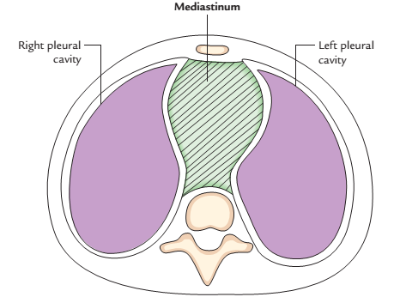
Cont’d
It is covered on either side by the mediastinal pleura.
Cross section of the thorax showing the position of the mediastinum

Slide 5
Cont’d
It contains the heart and its great blood vessels, esophagus, trachea and its bifurcation, thymus, thoracic ducts, lymph nodes, phrenic and vagus nerves.

Slide 6
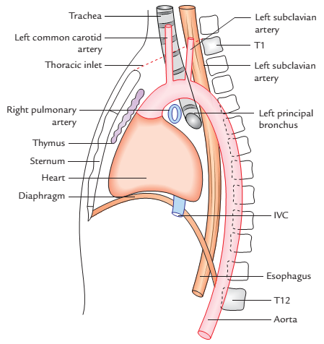
Boundaries
Anterior: Sternum
Posterior: Vertebral column
(bodies of thoracic vertebrae
and intervening
intervertebral discs)
Superior: Superior thoracic
aperture
Inferior: Diaphragm
On each side: Mediastinal pleura

Slide 7
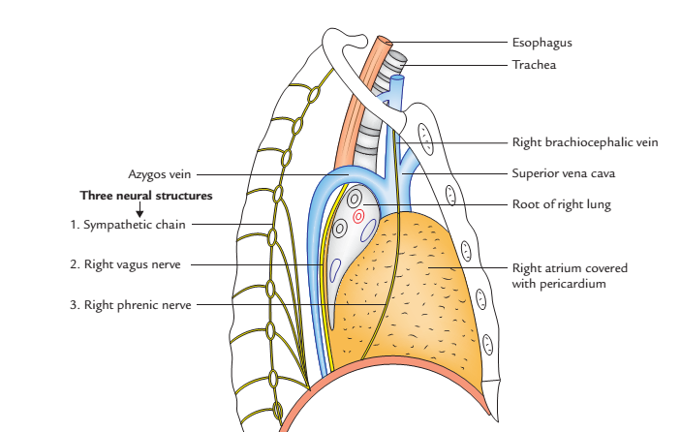
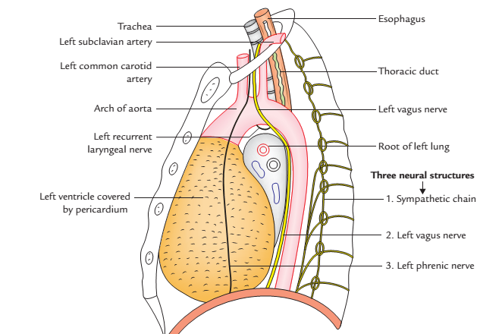
Cont’d
Mediastinal structures as seen from its lateral aspect in sagittal section of the thorax: A, right side; B, left side

Slide 8
Divisions
It is morphologically divided into two parts, for the purpose of description and organization of structures. (a) superior mediastinum and (b) inferior mediastinum by an imaginary plane (transverse thoracic plane) passing through the sternal angle anteriorly, and lower border of the body of the fourth thoracic (T4) vertebra/intervertebral disc T4 and T5 vertebrae posteriorly.

Slide 9
Cont’d
The inferior mediastinum is further subdivided into three parts by the pericardium (enclosing heart). The part in front of the pericardium is called anterior mediastinum, and the part behind the pericardium is called posterior mediastinum. The pericardium and its contents (heart and roots of its great vessels) constitute the middle mediastinum.

Slide 10
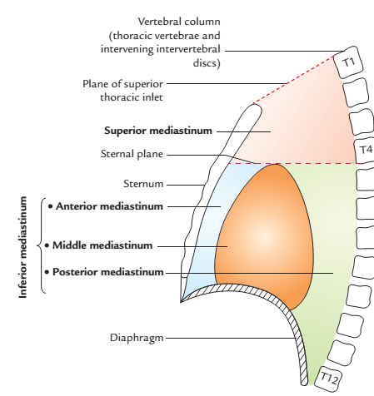
Cont’d
Divisions of the mediastinum

Slide 11
Superior Mediastinum
It is wedge-shaped. The anterior boundary is the manubrium,. The posterior boundary is the bodies of the first four thoracic vertebrae; this wall is concave towards the mediastinum. the posterior boundary is much longer due to the obliquity of the thoracic inlet

Slide 12
Boundaries
Anterior: Manubrium sterni.
Posterior: Bodies of upper four thoracic vertebrae.
Superior: Plane of superior thoracic aperture.
Inferior: An imaginary plane passing through the sternal angle in front and lower border of the body of fourth thoracic vertebra behind (transverse thoracic plane).
On each side (lateral): Mediastinal pleura.

Slide 13
Contents
1. Arteries
(a) Arch of aorta.
(b) Brachiocephalic artery.
(c) Left common carotid artery.
(d) Left subclavian artery.
2. Veins
(a) Right and left brachiocephalic veins.
(b) Upper half of the superior vena cava (SVC).
(c) Left superior intercostal vein.
3. Nerves
(a) Phrenic nerves (right and left).
(b) Vagus nerves (right and left).
(c) Sympathetic trunks and cardiac nerves (right and left).
(d) Left recurrent laryngeal nerves

Slide 14
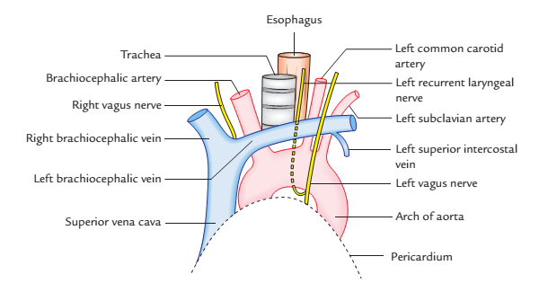
Cont’d
4. Lymphoid organs and lymphatics
(a) Lymph nodes.
(b) Thoracic duct.
(c) Thymus.
5. Tubes
(a) Trachea.
(b) Esophagus.
6. Muscles
(a) Sternohyoid.
(b) Sternothyroid.
(c) Longus colli.
Arrangement of structures in the superior mediastinum as seen in dissection

Slide 15
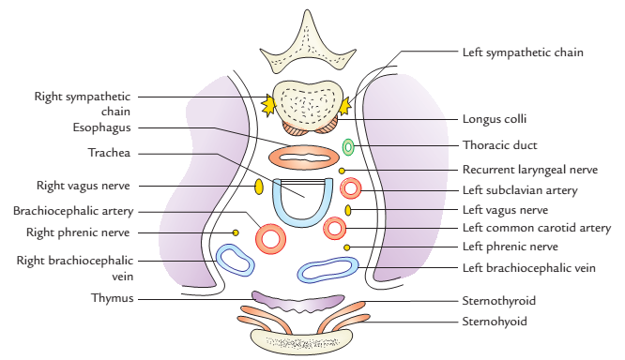
Cont’d
Transverse section of superior mediastinum showing the arrangement of its contents

Slide 16
Anterior Mediastinum
It lies between the pericardium and sternum. It is overlapped by the anterior edges of both lungs. It contains the thymus, sternopericardial ligaments, a few lymph nodes and branches of the internal thoracic vessels.

Slide 17
Boundaries
Anterior: Body of sternum.
Posterior: Pericardium enclosing heart.
Superior: Transverse thoracic plane separating superior and inferior mediastinum.
Inferior: Diaphragm.
On each side: Mediastinal pleura.

Slide 18
Contents
1. Loose areolar tissue.
2. Superior and inferior sternopericardial ligaments stretching between sternum and pericardium.
3. Three or four lymph nodes.
4. Mediastinal branches of internal thoracic (mammary) arteries.
5. Lower portion of thymus (in children).

Slide 19
Middle Mediastinum
The middle mediastinum contains the heart and pericardium, the adjoining parts of the great vessels, the lung roots, the phrenic nerves and the deep part of the cardiac plexus.

Slide 20
Boundaries
Anterior: Anterior mediastinum.
Posterior: Posterior mediastinum
Superior: Superior mediastinum.
Inferior: Diaphragm

Slide 21
Contents
1. Pericardium
2. Heart
3. Arteries:
(a) Ascending aorta
(b)Pulmonary trunk dividing into two pulmonary arteries
(c) Pericardiophrenic arteries
4. Veins:
(a) Superior vena cava (lower half)
(b) Azygos vein (terminal part)
(c) Pulmonary veins (right and left)

Slide 22
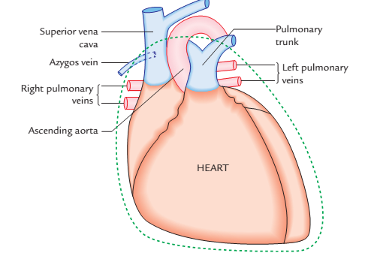
Cont’d
5. Nerves:
(a) Phrenic nerves
(b) Deep cardiac plexus
6. Lymph nodes:
Tracheobronchial
lymph nodes
7. Tubes:
(a) Bifurcation of trachea
Right and left
principal bronchi
Main contents of the middle mediastinum

Slide 23
Posterior Mediastinum
It is the space located posterior to the pericardium and to the doomed upper surface of the diaphragm. It is continuous directly, via the posterior part of the superior mediastinum, with the tissue spaces behind the pretracheal fascia and in front of the prevertebral fascia in the neck.

Slide 24
Boundaries
Anterior: pericardium and the sloping fibres of the diaphragm
Posterior: thoracic vertebrae (5-12).
Superior: Transverse thoracic plane separating superior mediastinum from the inferior mediastinum
Inferior: Diaphragm
On each side (lateral): Mediastinal pleura

Slide 25
Contents
Esophagus
Thoracic duct
Descending (thoracic) aorta and its branches
Azygos, hemiazygos, and accessory hemiazygos veins
Vagus nerve
Sympathetic trunks and splanchnic nerves
Posterior mediastinal lymph nodes

Slide 26
APPLIED ANATOMY

Slide 27
Cont’d
Mediastinitis: It is the inflammation of the loose connective tissue of the mediastinum. The fascial spaces of the neck (e.g., pretracheal and retropharyngeal spaces) extend below into the mediastinum within the thoracic cavity. Therefore, deep infections of the neck may readily spread into thoracic cavity causing mediastinitis.
Mediastinal syndrome: The compression of mediastinal structures by any growth such as tumour or cyst gives rise to a group of signs and symptoms, producing a clinical condition.

Slide 28
Cont’d
Subcutaneous emphysema at the root of neck: The structures that make up mediastinum are embedded in the loose connective tissue which is continuous with the loose connective tissue of the root of the neck. Therefore, in oesophageal perforations caused by penetrating wounds, air escapes into the connective tissue spaces of mediastinum and may ascend beneath the fascia to the root of the neck producing subcutaneous emphysema.

Slide 29
Cont’d
Potential dead space in superior mediastinum: In superior mediastinum, all large veins (superior vena cava, right and left brachiocephalic veins) are on the right side and all the large arteries (arch of aorta and its three branches) are on the left side. Consequently, during increased blood flow, the large veins expand enormously while the large arteries do not expand at all. This is because there is sufficient dead space on the right side. It is into this space that tumors of mediastinum tend to project.

Slide 30
Cont’d
Widening of the mediastinum: The widening of the mediastinum is often observed in chest radiographs. It can occur due to a certain number of factors, such as
Haemorrhage into the mediastinum from the lacerated great vessels (aorta, SVC) following trauma, e.g head on collision.
Enlargement (hypertrophy) of the heart due to congestive heart failure (CHF).It is the common cause of widening of inferior mediastinum.

Slide 31
Cont’d
Mediastinal shift: The mediastinal shift is common in lung and pleural diseases. The mediastinum shifts to the affected (diseased) side due to appreciable reduction in lung volume and decrease in intrapleural pressure as in collapse of lung and atelectasis. The mediastinum shifts to the healthy side when the intrapleural pressure is appreciably high on the affected side as in pneumothorax and hydrothorax.

Slide 32
Cont’d
It can be detected by palpating the trachea in the suprasternal notch.

Slide 33
Cont’d
The anterior mediastinum is a very narrow space. It is continuous through superior mediastinum with the pretracheal space of the neck. Therefore, neck infection in pretracheal space may spread into the anterior mediastinum.

Slide 34
Cont’d
Extension of pus into the posterior mediastinum from neck: The posterior mediastinum is continuous through superior mediastinum with spaces in the neck between pretracheal and prevertebral layers of deep cervical fascia such as retropharyngeal space etc. Therefore, pus from neck can extend into the posterior mediastinum.

Slide 35
Cont’d
Extension of pus into the thigh from posterior mediastinum: The psoas sheath communicates with the posterior mediastinum by a funnel-shaped orifice. Therefore, pus from posterior mediastinum can easily enter the psoas sheath and tracks down into the thighs in the region of femoral triangle.

Slide 36


Slide 37
PERICARDIUM

Slide 38
Outline
Intro’
Functions
Subdivisions
Layers: Fibrous, Visceral & Parietal layers
Pericardial cavity
Contents of the Pericardium
Pericardium Sinuses
Arterial supply
Nerve supply
Lymphatic drainage
Applied Anatomy

Slide 39
Intro’
The pericardium is a fibroserous sac which encloses the heart, and the roots of its great blood vessels. It lies within the middle mediastinum, posterior to the body of the sternum and 2nd-6th costal cartilages and anterior to the middle four thoracic vertebrae (i.e., from T5 to T8).

Slide 40
Functions
It restricts excessive movements of the heart
It serves as a lubricated container in which heart can contract and relax smoothly, and
It limits the cardiac distension.

Slide 41
Subdivisions
The pericardium consists of two components:
an outer single layered fibrous sac called fibrous pericardium.
(b) inner double layered serous sac called serous pericardium.

Slide 42
Cont’d
The heart and great vessels lie inside the fibrous sac and invaginate the serous sac from behind during development. As a result, the external surface of the heart and internal surface of the fibrous pericardium are covered by a layer of serous pericardium. The layer covering the surface of the heart is called visceral pericardium or epicardium and the layer covering the inner aspect of the fibrous pericardium is called parietal pericardium. The intervening potential space between the two serous layers is called pericardial cavity.

Slide 43
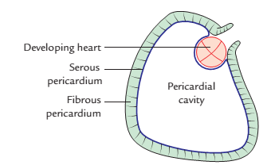
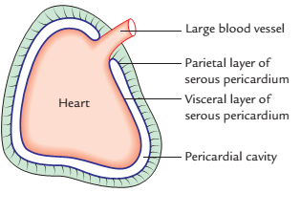
Development of different layers of the pericardium

Slide 44
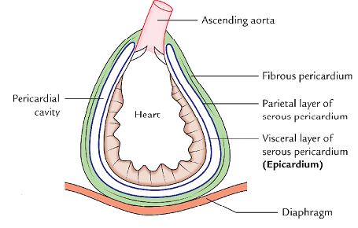
The pericardium consists of three layers
From outside to inwards these are:
1. Fibrous layer of the pericardium.
2. Parietal layer of the serous pericardium.
3. Visceral layer of the serous pericardium (epicardium).
Layers of pericardium

Slide 45
FIBROUS PERICARDIUM
It is strong fibrous sac which supports the delicate parietal layer of the serous pericardium with which it is firmly adherent.
Features
The features of fibrous pericardium are as follows:

Slide 46
The features of fibrous pericardium
It is conical in shape
Its apex is blunt and fused with the outer coats of the roots of great blood vessels (e.g., ascending aorta, pulmonary trunk).
Its base is broad and blended with the central tendon of the diaphragm.
Anteriorly, it is connected to the posterior aspect of the body of sternum by the superior and inferior sternopericardial ligaments.

Slide 47
Cont’d
Posteriorly, It is related to principal bronchi, oesophagus, and descending thoracic aorta.
On each side, it is related to phrenic nerve and pericardiophrenic vessels.

Slide 48
SEROUS PERICARDIUM
It is thin serous membrane lined by mesothelium. It is double layered, the outer layer is called parietal layer and the inner layer is called visceral layer.
The outer layer lines the fibrous pericardium and is reflected around the roots of great blood vessels to become continuous with the visceral layer of the pericardium. It is called parietal pericardium.

Slide 49
Cont’d
The inner layer is closely applied to the heart except along the cardiac grooves, where it is separated from the heart by blood vessels. It is called visceral pericardium or epicardium.

Slide 50
Differences between the parietal and serous pericardium
Parietal pericardium | Visceral pericardium
It is attached to the fibrous pericardium | It is attached to the myocardium of the heart
It develops from somatopleuric mesoderm | It develops from splanchnopleuric mesoderm
It is innervated by the somatic nerve fibres | It is innervated by the autonomic nerve fibres
It is sensitive to pain | It is insensitive to pain

Slide 51
Pericardial Cavity
The Slit-like potential space between the parietal and visceral layers of serous pericardium. It is containing a thin film of serous fluid (about 50 ml) called pericardial fluid which lubricates the opposed surfaces to avoid friction during the movements of the heart.

Slide 52
Contents of the Pericardium
Heart with its vessels and nerves
Ascending aorta
Pulmonary trunk
Superior vena cava
Inferior vena cava
Pulmonary veins

Slide 53
Sinuses of Pericardium
There are two sinuses between the parietal and visceral layers of serous pericardium:
Transverse sinus
Oblique sinus
The sinuses of pericardium are formed due to the reflection of visceral layer of serous pericardium around great vessels of the heart.
The visceral pericardium (epicardium) at the roots of great blood vessels is arranged into tubes: (a) arterial tube and (b) venous tube.

Slide 54
Cont’d
The arterial tube encloses the ascending aorta and pulmonary trunk (arterial end of the heart tube).
The venous tube encloses the superior, inferior vena cava and four pulmonary veins (venous end of the heart tube).

Slide 55
Transverse Sinus of Pericardium
It is a transverse recess behind the ascending aorta, pulmonary trunk in front, superior vena cava, left atrium, and pulmonary veins behind. It develops due to degeneration of dorsal mesocardium.
It is a horizontal passage between the two pericardial tubes. On each side, it communicates with the general pericardial cavity.

Slide 56
Oblique Sinus of Pericardium
It is a space behind the base of the heart between the left atrium, in front and the fibrous pericardium behind, posterior to which lies the oesophagus. It is enclosed by ‘J-shaped’ sheath of visceral layer of serous pericardium enclosing six veins (i.e., 2 vena cavae and 4 pulmonary veins).

Slide 57
Cont’d
The oblique sinus is similar to lesser sac behind the stomach and develops as a result of absorption of four pulmonary veins into the left atrium. The oblique sinus permits the distension of left atrium during return of oxygenated blood in it from the lungs.

Slide 58
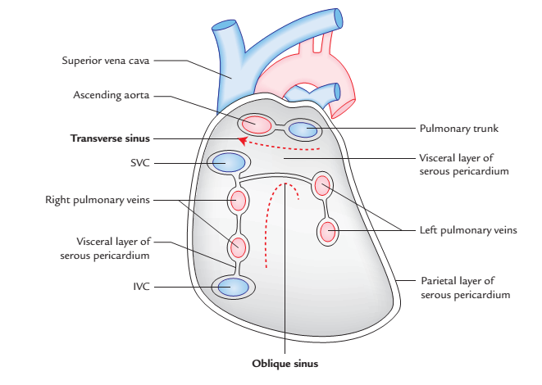
Interior of the serous pericardial sac after section of the large vessels and removal of the heart showing transverse and oblique pericardial sinuses.

Slide 59
Boundaries of the Oblique sinus
Oblique sinus of pericardium is bounded in the following way:
Anteriorly: by left atrium.
Posteriorly: by parietal pericardium.
On right side: by reflection of visceral pericardium along the right pulmonary veins and inferior vena cava.
On the left side: by reflection of visceral pericardium along the left pulmonary veins.

Slide 60
Cont’d
Superiorly: by reflection of visceral pericardium along the right and left superior pulmonary veins.

Slide 61
Arterial Supply
The fibrous pericardium and parietal layer of serous pericardium is supplied by the branches of the following arteries.
Internal thoracic artery.
Musculophrenic artery.
Pericardiophrenic artery
Thoracic (Descending) aorta.
The visceral layer of serous pericardium is supplied by the coronary arteries.

Slide 62
Nerve Supply
The fibrous pericardium and parietal layer of the serous pericardium are supplied by the phrenic nerves (somatic nerve fibres).
The visceral layer of the serous pericardium is supplied by the branches of sympathetic trunks and vagus nerves (autonomic nerve fibres).

Slide 63
APPLIED ANATOMY
Pericarditis: The inflammation of the serous pericardium is called pericarditis which causes accumulation of serous fluid in the pericardial cavity, the pericardial effusion.
Cardiac tamponade: The excessive accumulation of serous fluid in the pericardial cavity may compress the thin-walled atria and interfere with the filling of the heart during diastole and consequently the cardiac output is diminished.

Slide 64
Cont’d
Pericardiocentesis: Excessive pericardial fluid can be aspirated from the pericardial cavity by two routes:
Sternal approach
Subxiphoid approach
Pericardial friction rub:The roughening of parietal and visceral layers of the serous pericardium by inflammatory extremely can cause friction between the two layers called pericardial friction rub which can be felt on palpation and heard through the stethoscope.

Slide 65
Cont’d
Surgical significance of transverse pericardial sinus: During cardiac procedure, after the pericardial sac is opened anteriorly, a finger is passed through the transverse sinus of pericardium, posterior to the aorta and pulmonary trunk. A temporary ligature is passed through the transverse sinus around the aorta and pulmonary trunk. The tubes of heart-lung machine are inserted into these vessels and ligature is tightened.

Slide 66
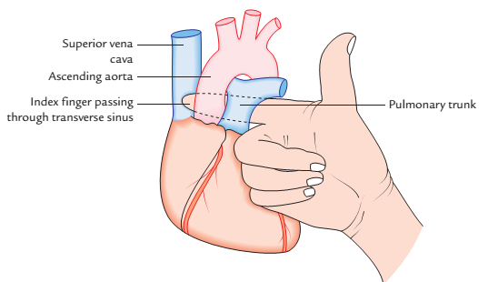
Finger passing through the transverse pericardial sinus

Slide 67
ANATOMY OF THE PLEURA

Slide 68
Outline
Intro’
Layers: Visceral & Parietal layers
Subdivisions of Parietal pleura
Pleural cavity
Pleural recesses (Costodiaphramatic & Costomediastinal)
Arterial supply
Nerve supply
Lymphatic drainage
Applied Anatomy

Slide 69
PLEURA
The pleura is a thin membrane of fibrous tissue surfaced by a single layer of flat cells (mesothelium). The lining epithelium secretes a watery lubricant-the serous fluid. It clothes each lung and lines the thoracic cavity.

Slide 70
LAYERS OF THE PLEURA
The pleura consist of two layers: (a) visceral pleura and (b) parietal pleura. The moistened space between the two layers is called pleural cavity.

Slide 71
Parietal Pleura
The parietal layer of the pleura lines the thoracic wall (rib cage, vertebrae, and diaphragm), from which it is separated by loose areolar tissue, the endothoracic fascia. But the parietal pleura is attached to the inferior surface of the suprapleural membrane, at the thoracic inlet, and to the mediastinal surface of the fibrous pericardium.

Slide 72
Cont’d
It, however, extends further than the inferior lung edge, to allow space for lung expansion. In these situations, the costal parietal pleura is in contact with the mediastinal and diaphragmatic parietal pleura.

Slide 73
Visceral Pleura (Pulmonary Pleura)
The visceral pleura completely covers the surface of the lung except at the hilum and along the attachment of the pulmonary ligament. It also extends into the depths of the fissures of the lungs. It extends into the depths of the interlobar clefts and is firmly adherent to the lung surface and cannot be separated from it. The pleura cavity is a completely closed space. The visceral pleura on the lung surface is in contact with the parietal pleura.

Slide 74
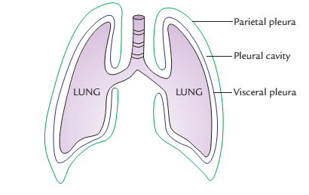
Cont’d

Slide 75
Parietal Pleura
The parietal pleura is thicker than the visceral pleura and lines the walls of the pulmonary cavity.
Subdivisions
Parietal pleura, which it lines, according to the surface, covers or the region in which it lies. Thus parietal pleura is divided into the following four parts: 1, Costal pleura; 2, Diaphragmatic pleura; 3, Mediastinal pleura; 4, Cervical pleura.

Slide 76
Subdivisions of Parietal pleura
Costal pleura: It lines the inner surface of the thoracic wall (consisting of ribs, costal cartilages, and intercostal spaces) to which it is loosely attached by a thin layer of loose areolar tissue called endothoracic fascia. In living beings, It is easily separated from the thoracic wall.

Slide 77
Cont’d
Diaphragmatic pleura: It covers the superior surface of the diaphragm. In quiet respiration, the costal, and diaphragmatic pleura are in opposition to each other below the inferior border of the lung.
Mediastinal pleura: It lines the corresponding surface of the mediastinum and forms its lateral boundary. It is reflected as a cuff over the root of the lung and becomes continuous with the visceral pleura.

Slide 78
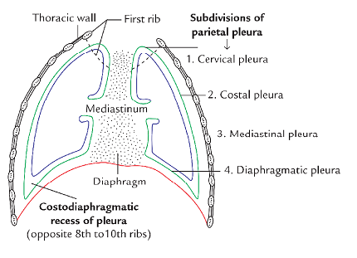
Cont’d

Slide 79
Cont’d
Cervical pleura: It is the dome of parietal pleura, which extends into the root of the neck about 1 inch (2.5 cm) above the medial end of clavicle and 2 inches (5 cm) above the 1st costal cartilage. It is called cupola and covers the apex of the lung. It is covered by the suprapleural membrane.

Slide 80
PLEURAL CAVITY

Slide 81
Cont’d
The parietal and visceral layers are separated from each other by a slit-like potential space called pleural cavity. The pleural cavity is normally filled with a thin film of tissue fluid, which lubricates the adjoining surfaces of the pleura and allows them to move on each other without friction. The two layers become continuous with each other by means of a cuff of pleura, which surrounds the root of the lung consisting of structures entering and leaving the lung at the hilum of the lung, such as principal bronchi and pulmonary vessels.

Slide 82
Cont’d
To allow the movement of principal bronchi and pulmonary vessels during respiration, the cuff of pleura hangs down as an empty fold, called the pulmonary ligament.
It provides dead space into which the descent of the root of the lung with descent of the diaphragm, and allows for expansion of vessels in the lung root during inspiration, especially the inferior pulmonary vein. It extends from root of the lung as far down as the diaphragm between the lung and the mediastinum.

Slide 83
RECESSES OF THE PLEURA

Slide 84
RECESSES OF THE PLEURA
In areas of pleural reflection on to the diaphragm, and mediastinum, the space between the parietal and visceral pleura is greatly expanded. These expanded regions of pleural cavity are called pleural recesses. They are essential for lung expansion during deep inspiration. They serve as reserve spaces of pleural cavity for the lungs to expand during deep inspiration. The recesses of pleura are as follows:
Costodiaphragmatic recesses (right and left).
Costomediastinal recesses (right and left).

Slide 85
Costodiaphragmatic recess
It is located inferiorly between the costal and diaphragmatic pleurae. It measures about 5 cm and lies opposite the 8th-10th ribs along the midaxillary line, vertically.
They are the most dependent parts of the pleural cavities, hence the fluid of pleural effusion first collect at these sites.

Slide 86
Costomediastinal recess
It is located anteriorly between the costal and mediastinal pleurae and lies between sternum and costal cartilages. The right costomediastinal recess is possibly occupied by the anterior margin of the right lung even during quiet breathing. The left costomediastinal recess is large due to the presence of cardiac notch in the left lung. Its location can be confirmed clinically by percussion (tapping) of the chest wall.

Slide 87
Cont’d
Area of superficial cardiac dullness: As one moves during tapping from the area of underlying lung tissue to the area of left costomediastinal recess unoccupied by lung tissue, a change in tone, from resonant to dull, is noticed.

Slide 88
ARTERIAL SUPPLY OF THE PLEURA
Intercostal artery
Internal thoracic artery
Musculophrenic artery

Slide 89
NERVE SUPPLY OF THE PLEURA
Costovertebral pleura, costal and peripheral part of the diaphragmatic pleura is supplied by the intercostal nerves.
Mediastinal pleura and central part of the diaphragmatic pleura is supplied by the phrenic nerve.
The parietal pleura develops from somatopleuric layer of the lateral plate of mesoderm, hence it is supplied by the somatic nerves and is sensitive to pain.

Slide 90
Cont’d
The visceral pleura develops from splanchnopleuric layer of the lateral plate of mesoderm, hence it is supplied by the autonomic (sympathetic) nerves (T2-T5) and is insensitive to pain.

Slide 91
LYMPHATIC
DRAINAGE OF THE PLEURA
Intercostal lymph node
Parasternal lymph node
Diaphragmatic lymph node
Posterior mediastinal lymph node.

Slide 92
Differences between the parietal and visceral pleurae
Parietal pleura | Visceral pleura
Lines the thoracic wall and mediastinum | Lines the surface of the lung
Develops from the somatopleuric mesoderm | Develops from the splanchnopleuric mesoderm
Innervated by the somatic nerves | Innervated by the autonomic nerves
Sensitive to pain | Insensitive to pain

Slide 93
APPLIED ANATOMY
Pleurisy or pleuritis: It is the inflammation of the parietal pleura. lt usually presents as pain, which is exacerbated by respiratory movements and radiates to thoracic and abdominal walls. The pleural surface becomes rough due to accumulation of inflammatory exudate. Due to roughening of the pleural surfaces friction occurs between the two layers of pleura during respiratory movements.

Slide 94
Cont’d
The collection of serous fluid, air, blood, and pus in the pleural cavity is termed hydrothorax (pleural effusion), pneumothorax, hemothorax, and pyothorax (empysema), respectively.
Pleural effusion: The excessive accumulation of fluid in the pleural cavity is called pleural effusion. It usually occurs due to inflammation of pleura.

Slide 95
Cont’d
Thoracocentesis/pleural tab: It is a procedure by which an excess fluid is aspirated from the pleural cavity. Normally, the needle is inserted in the 6th intercostal space in the midaxillary line. The needle passes in succession through skin, superficial fascia, serratus anterior, intercostal muscles, endothoracic fascia, and parietal pleura to reach the pleural cavity. The needle is inserted into the lower part of the intercostal space along the upper border of the rib to avoid injury to the intercostal nerve and vessels.

Slide 96
THANK YOU, ALL FOR LISTENING.

